Slide 1
Financing

Slide 2
finance, the process of raising funds or capital for any kind of expenditure. Consumers, business firms, and governments often do not have the funds available to make expenditures, pay their debts, or complete other transactions and must borrow or sell equity to obtain the money they need to conduct their operations. Savers and investors, on the other hand, accumulate funds which could earn interest or dividends if put to productive use. These savings may accumulate in the form of savings deposits, savings and loan shares, or pension and insurance claims; when loaned out at interest or invested in equity shares, they provide a source of investment funds. Finance is the process of channeling these funds in the form of credit, loans, or invested capital to those economic entities that most need them or can put them to the most productive use. The institutions that channel funds from savers to users are called financial intermediaries. They include commercial banks, savings banks, savings and loan associations, and such nonbank institutions as credit unions, insurance companies, pension funds, investment companies, and finance companies.
Three broad areas in finance have developed specialized institutions, procedures, standards, and goals: business finance, personal finance, and public finance. In developed nations, an elaborate structure of financial markets and institutions exists to serve the needs of these areas jointly and separately.

Slide 3
Elements of knowledge industry growth ecosystem
The growing awareness that knowledge-based capital (KBC) is driving economic growth is prevalent in today’s global marketplace. KBC includes a broad range of intangible assets, like research, data, software and design skills, which capture or express human ingenuity. The creation and application of knowledge is especially critical to the ability of firms and organizations to develop in a competitive global economy and to create high-wage employment.

Slide 4
Elements of knowledge industry growth ecosystem
The Growth of STEM Jobs
The knowledge economy is considered the primary driver of the massive expansion of what is known as STEM jobs. STEM is short for “science, technology, engineering, and mathematics.” Careers within the STEM fields – which includes occupational paths such as computer science, engineering, chemistry, and biology – are where many of the greatest opportunities for career advancement, higher compensation, and top-level executive positions can be found.
The bottom line is that knowledge provides the foundation for the necessary technical expertise, data collection and analysis skills, and innovative management practices that enable companies and businesses to compete in the modern, global economy. Specialized knowledge and skills may serve as either productive assets for a business to employ, or as products for a business to market and sell.

Slide 5
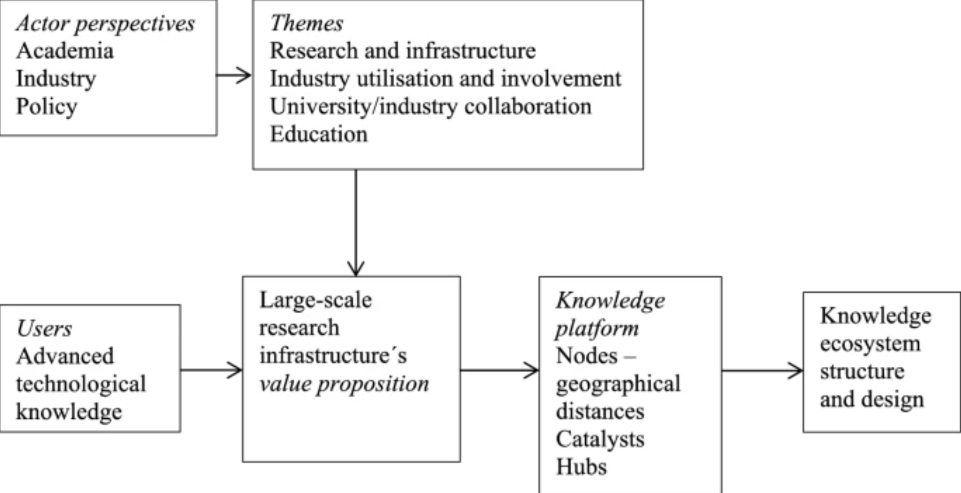
Elements of knowledge industry growth ecosystem

Slide 6
Elements of knowledge industry growth ecosystem
B2B and business network scholars have increasingly begun applying the “ecosystem” concept.
The study provides a systematic review on the use of ecosystem conceptualization in B2B studies.
Four categories for the application of the concept in B2B and business network research are identified.
The paper recognizes four shifts of management in the ecosystem era.
We suggest a revised network management framework, where the ecosystem can be considered as a layer or perspective.

Slide 7
Concept of Venture capital
What Is Venture Capital (VC)?
Venture capital (VC) is a form of private equity and a type of financing that investors provide to startup companies and small businesses that are believed to have long-term growth potential. Venture capital generally comes from well-off investors, investment banks, and any other financial institutions. However, it does not always take a monetary form; it can also be provided in the form of technical or managerial expertise. Venture capital is typically allocated to small companies with exceptional growth potential, or to companies that have grown quickly and appear poised to continue to expand.
Though it can be risky for investors who put up funds, the potential for above-average returns is an attractive payoff. For new companies or ventures that have a limited operating history (under two years), venture capital is increasingly becoming a popular—even essential—source for raising money, especially if they lack access to capital markets, bank loans, or other debt instruments. The main downside is that the investors usually get equity in the company, and, thus, a say in company decisions.

Slide 8
Concept of Venture capital
Venture capital financing is funding provided to companies and entrepreneurs. It can be provided at different stages of their evolution, although it often involves early and seed round funding.
Venture capital funds manage pooled investments in high-growth opportunities in startups and other early-stage firms and are typically only open to accredited investors.
Venture capital has evolved from a niche activity at the end of the Second World War into a sophisticated industry with multiple players that play an important role in spurring innovation.

Slide 9
Concept of Venture capital
Understanding Venture Capital
In a venture capital deal, large ownership chunks of a company are created and sold to a few investors through independent limited partnerships that are established by venture capital firms. Sometimes these partnerships consist of a pool of several similar enterprises.
One important difference between venture capital and other private equity deals, however, is that venture capital tends to focus on emerging companies seeking substantial funds for the first time, while private equity tends to fund larger, more established companies that are seeking an equity infusion or a chance for company founders to transfer some of their ownership stakes.

Slide 10
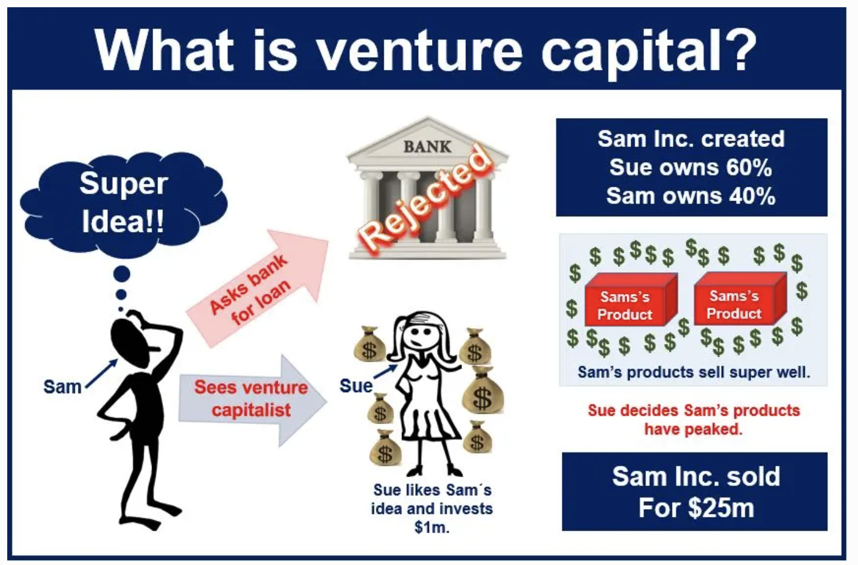
Concept of Venture capital

Slide 11
Concept of Venture capital
Angel Investors
For small businesses, or for up-and-coming businesses in emerging industries, venture capital is generally provided by high net worth individuals (HNWIs)—also often known as "angel investors"—and venture capital firms. The National Venture Capital Association (NVCA) is an organization composed of hundreds of venture capital firms that offer to fund innovative enterprises.
Angel investors are typically a diverse group of individuals who have amassed their wealth through a variety of sources. However, they tend to be entrepreneurs themselves, or executives recently retired from the business empires they've built.
Self-made investors providing venture capital typically share several key characteristics. The majority look to invest in well-managed companies, that have a fully-developed business plan and are poised for substantial growth. These investors are also likely to offer to fund ventures that are involved in the same or similar industries or business sectors with which they are familiar. If they haven't worked in that field, they might have had academic training in it. Another common occurrence among angel investors is co-investing, in which one angel investor funds a venture alongside a trusted friend or associate, often another angel investor.

Slide 12
Concept of Venture capital
The Venture Capital Process
The first step for any business looking for venture capital is to submit a business plan, either to a venture capital firm or to an angel investor. If interested in the proposal, the firm or the investor must then perform due diligence, which includes a thorough investigation of the company's business model, products, management, and operating history, among other things.
Since venture capital tends to invest larger dollar amounts in fewer companies, this background research is very important. Many venture capital professionals have had prior investment experience, often as equity research analysts; others have a Master in Business Administration (MBA) degree. Venture capital professionals also tend to concentrate on a particular industry. A venture capitalist that specializes in healthcare, for example, may have had prior experience as a healthcare industry analyst.

Slide 13
Concept of Venture capital
Why Is Venture Capital Important?
Innovation and entrepreneurship are the kernels of a capitalist economy. New businesses, however, are often highly-risky and cost-intensive ventures. As a result, external capital is often sought to spread the risk of failure. In return for taking on this risk through investment, investors in new companies are able to obtain equity and voting rights for cents on the potential dollar. Venture capital, therefore, allows startups to get off the ground and founders to fulfill their vision.

Slide 14
https://www.sciencedirect.com/science/article/abs/pii/S0019850117306545?via%3Dihub
https://www.researchgate.net/publication/228132260_Value_Creation_by_Knowledge-Based_Ecosystems_Evidence_from_a_Field_Study
https://www.investopedia.com/terms/v/venturecapital.asp#:~:text=Venture%20capital%20(VC)%20is%20a,and%20any%20other%20financial%20institutions.

